Slide 1

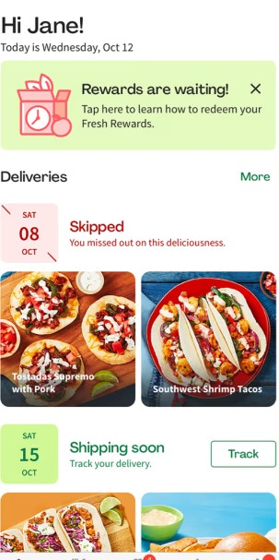
Pricing Strategy for Students
Anukul, Meenakshi, Pratyush
Course: Demand Analytics
Date: April 16th, 2024

Slide 2
01
02
03
04
Business Context
Experiment Design
Analysis
Recommendations
GoFresh and the need for a different pricing strategy
Survey design and Methodology
Process to optimum price discovery
Discussion of experiment results

Slide 3
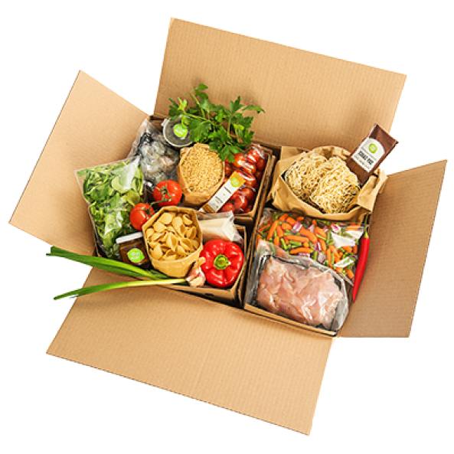

Business Context
GoFresh Leading meal kit delivery service
Currently serves a large young professional customer base
Established leader in the meal kit delivery market
Pre-portioned ingredients and recipe cards

Slide 4
Business Context
Problem Description
Growing student demand for convenient and healthy meal options
GoFresh is seeking an entry strategy for the student market
Data Overview
The experiment uses a stated preference measurement approach through a survey conducted among students
Objective
To identify optimal product profiles and attributes for a pilot program that will maximize market share in the student market.

Slide 5
Experiment Design
Attributes considered
Meal Type | Meat and Veggies | Fit and Wholesome | Plant Based | Cooked under 20 minutes
Number of Meals per day | 1 | 2 | 3 | -
Number of Days | 3 | 7 | 14 | 30
Price per Meal | 3.5 | 4 | 4.5 | 5

Slide 6
Experiment Design
Profiles considered
Observations | Meal type | Number of meals per day | Number of days | Price per meal
Profile 1 | Plant Based | 2 | 30 | 3.5
Profile 2 | Meat And Veggies | 1 | 3 | 4
Profile 3 | Plant Based | 1 | 7 | 4.5
Profile 4 | Cooked under 20 minutes | 2 | 3 | 4.5
Profile 5 | Meat And Veggies | 2 | 14 | 5
Profile 6 | Cooked under 20 minutes | 1 | 30 | 5
Profile 7 | Fit and Wholesome | 3 | 30 | 4.5
Profile 8 | Meat And Veggies | 3 | 7 | 3.5
Profile 9 | Plant Based | 3 | 3 | 5
Profile 10 | Fit and Wholesome | 2 | 7 | 4
Profile 11 | Fit and Wholesome | 1 | 14 | 3.5
Profile 12 | Cooked under 20 minutes | 3 | 14 | 4

Slide 7
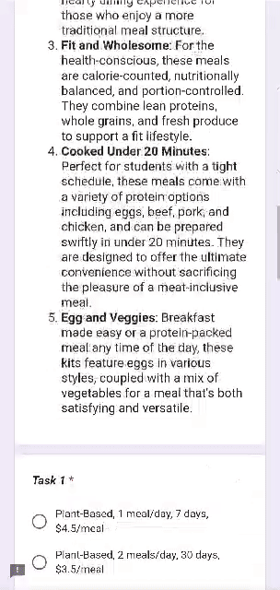
Survey Design
Data Collection: Data was collected through a Google Form
Survey Participants: Graduate students (32 participants)
Questionnaire Structure: The survey included six tasks where respondents chose between three alternative profiles and a “none” option
Profile Attributes: Survey profiles varied in meal type, number of meals per day, number of days, and price per meal as generated via XLSTAT's conjoint analysis

Slide 8
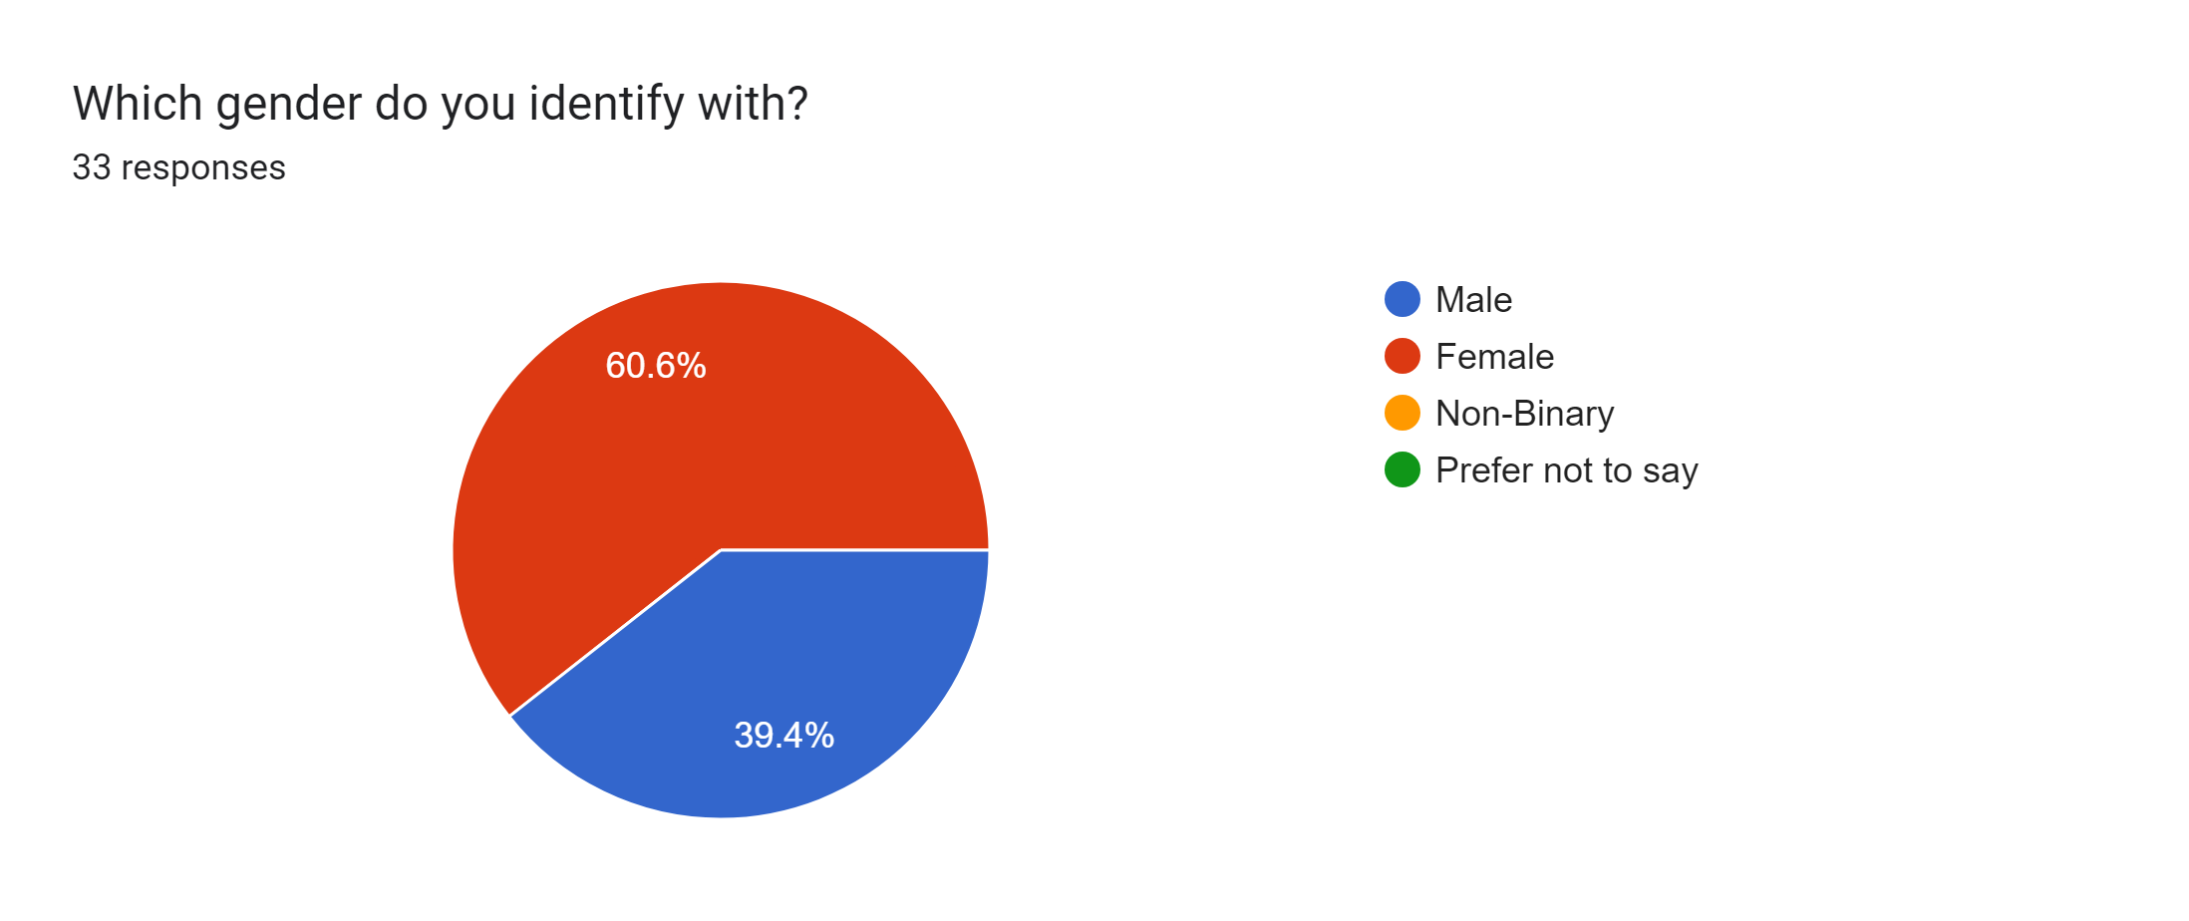
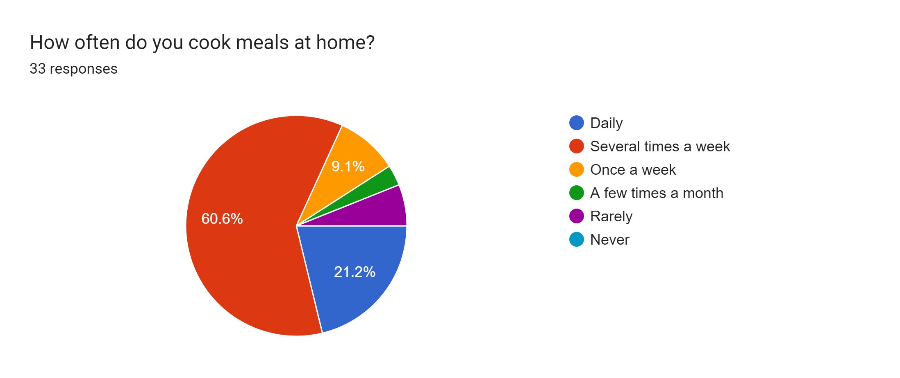
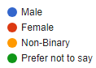
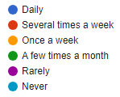
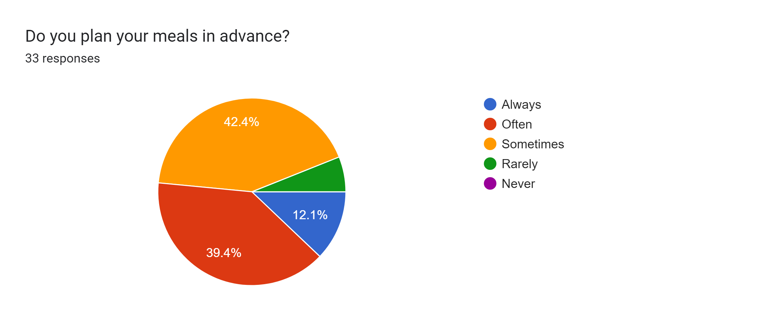
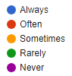
Respondent Demographics
Gender
Cooking Frequency
Meal Preparation in Advance

Slide 9
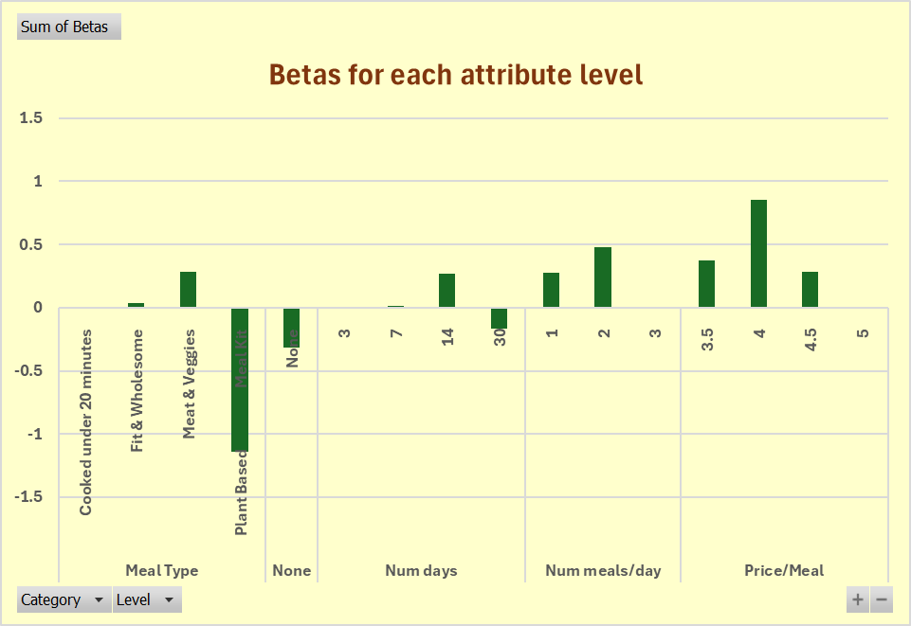
Attribute Utilities

Slide 10
Top Utilities

Slide 11
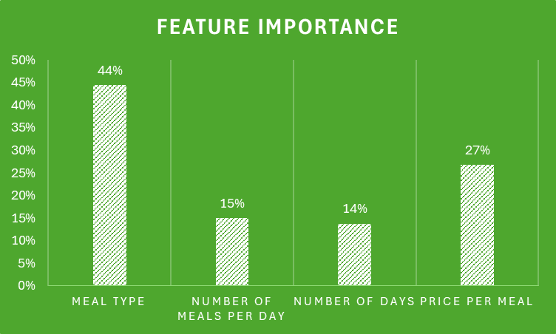
Key Findings
A clear importance to Meal type and Price per meal

Slide 12
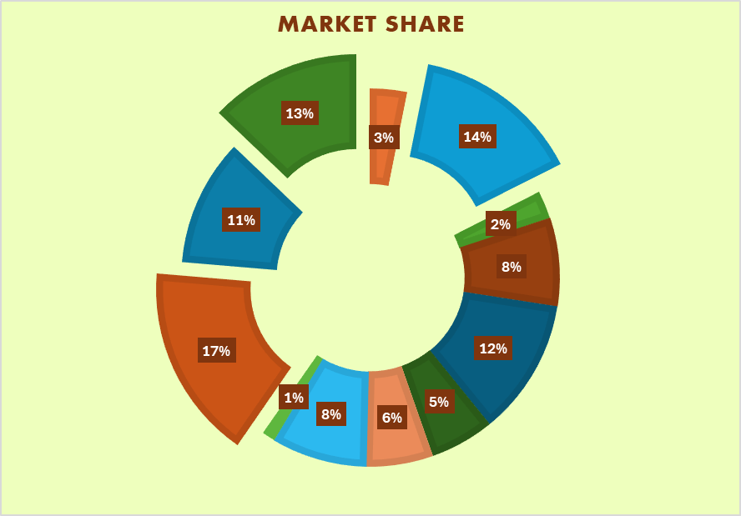
Key Findings
Top 3 product Profiles
Fit and Wholesome, 2 meals/day,14 days, $4 per meal
Meat and Veggies, 1 Meal/day, 3 days, $ 4 per meal
Cooked Under 20 minutes, 3 meals/day, 14 days, $ 4 per meal

Slide 13
Market Simulation
Attributes considered
Meal Type | Meat & Veggies | Fit & Wholesome
Num Meals/day | 2 | -
Num Days | 14 | -
Price/Meal | 3.5 | 4
Selected Profiles Via Conjoint
Meal type | Num Meals /Day | Num Days | Price/ Meal
Meat and Veggies | 2 | 14 | $3.50
Fit and Wholesome | 2 | 14 | $4

Slide 14
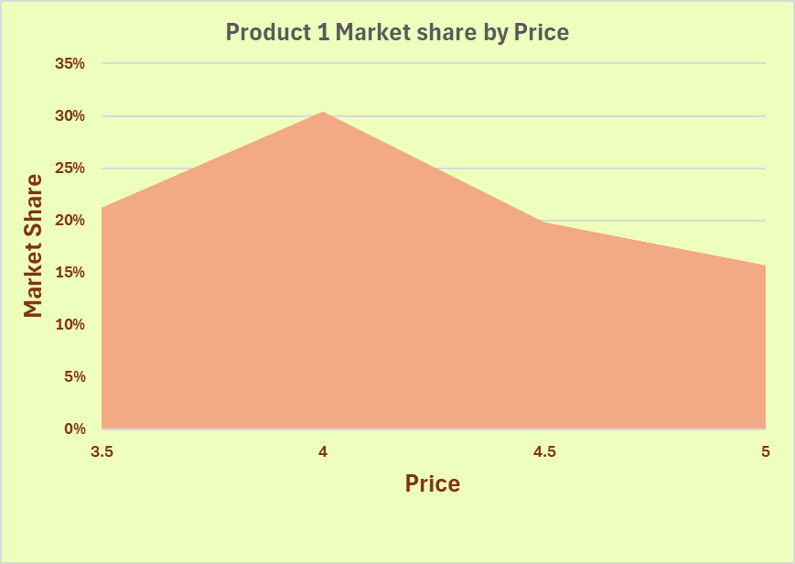
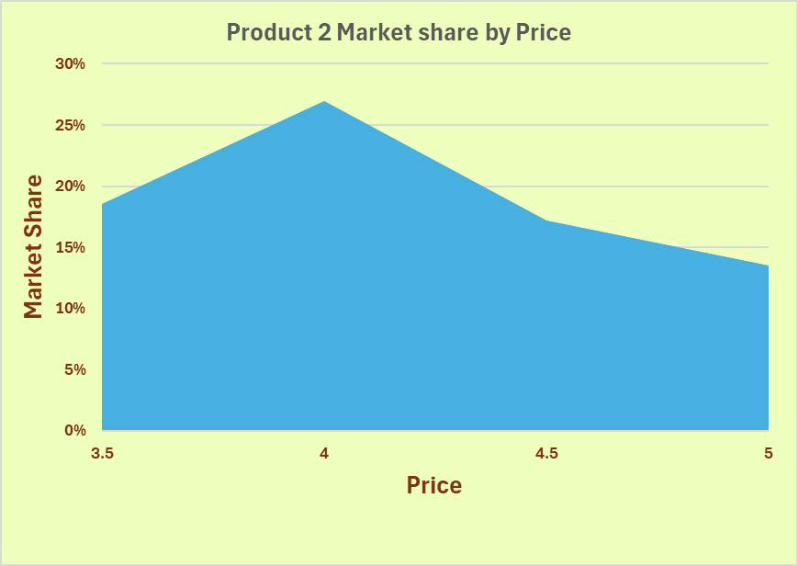
Demand Curves

Slide 15
Recommendations
Meat and Veggies
Student Discounts
Higher portion sizes
Partnerships
Focus on subscription packages of 2 meals/day for 14 days
Implement student discounts and promotional offers. A free breakfast or supplementary meals.
Value for money by giving larger portion sizes for students
Partner with universities and student organizations

Slide 16

Thanks!
Do you have any questions?
Please keep this slide for attribution.

